Slide 1


Team 16: Solar Power Battery
Bi-Weekly Update 1 Lauren Lugo, Tarik Dawson, Clement Ong, Nathan Gil Sponsor: Peng-Hao Huang TA: Dalton W. Cyr
Notes:
Michelle

Slide 2
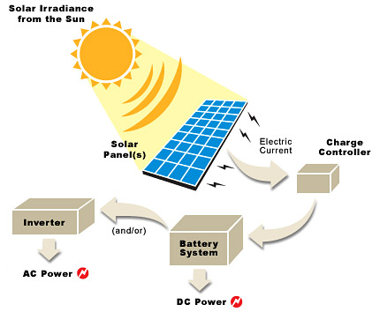
Project Summary
Problem Statement:
Provide the user with an independent solar power generating system that can charge both AC and DC devices
Solution proposal:
Develop independent power grid using a solar panel that can charge the majority of items throughout the day and night. Both AC and DC power provided.
Notes:
Kyle

Slide 3
Project/Subsystem Overview
Clement
DC-AC Inverter
Tarik
Solar Panel
DC-DC Converter
Switch
DC Load
Lauren
DAC
Batteries
Switch
MPPT Algorithm (MCU)
Voltage Regulation
Nathan
Computer Application
Phone Application
Notes:
Eric

Slide 4
Major Project Changes for 404
No Major Changes
Notes:
Eric

Slide 5
Project Timeline
(Complete)
(Ongoing)
(Ongoing)
(Not Started)
(Not Started)
Finalize Subsystems
Validate Individual Subsystems
Integration Between Subsystems
Validate System
Final Demo
Team members have finalized their designs and making finishing touches on subsystem
Team will finalize and validate individual subsystems
ESP32 and Database is undergoing integration for bi-direction communication. Sensors/switches undergoing integration between DC-DC and ESP32.
Team will validate entire system to ensure accuracy and functionality
Team will demo the final completed system
Notes:
Eric

Slide 6
MPPT
Lauren Lugo
Accomplishments since 403 6 hrs of effort | Ongoing progress/problems and plans until the next presentation
List of Parts Helped organize PCB boards Checked all current designs are working | Connect to Wifi and Database Send in part order by end of week Recode current sensors to get proper output

Slide 7
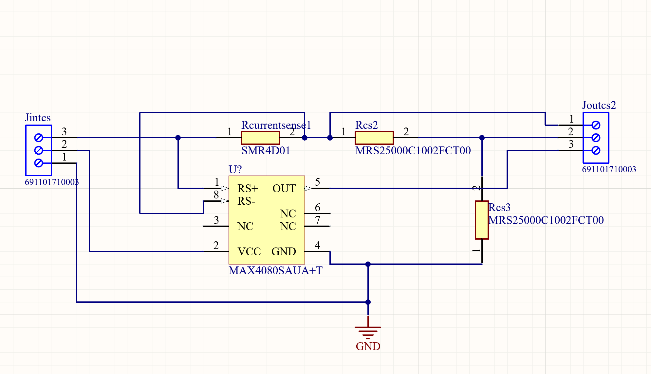
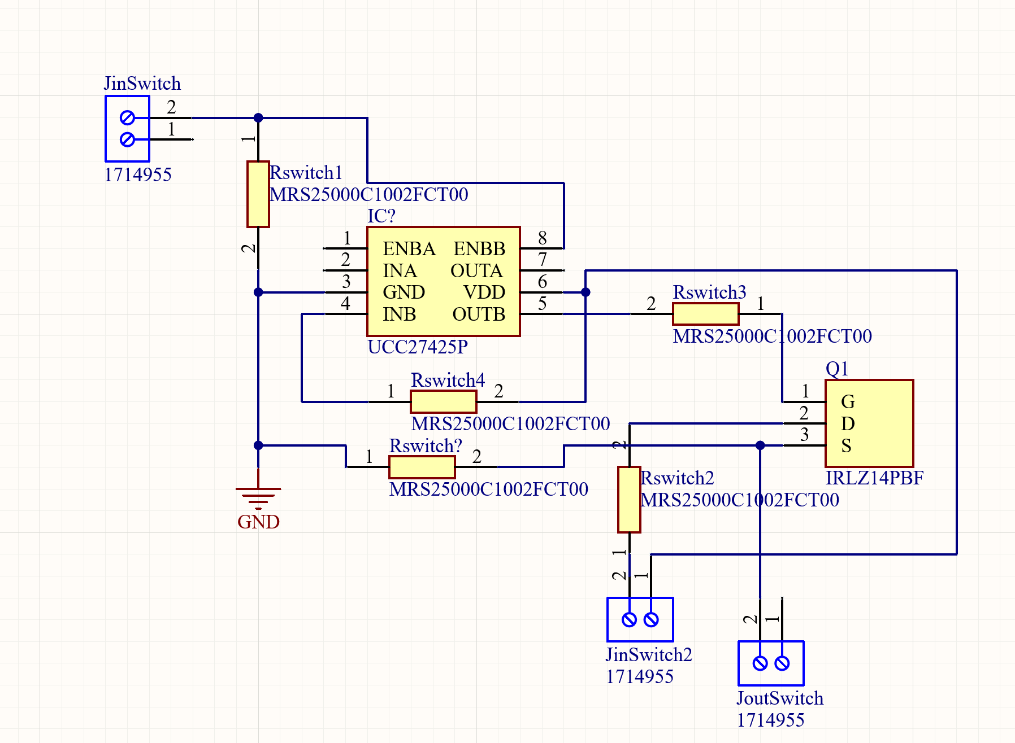
MPPT
Lauren Lugo
Current and Voltage Sensor
Voltage sensor is made of a voltage divider
Current sensor is a 10mOhm resistor and a Op Amp
Output sent to MCU
Switch
Driver Mosfet design
Output across the source
Only putting switches after the DC-DC output and at the battery
MCU/ESP32
Code works well to control switches depending on the inputs from the sensors
Need to connect to wifi and database
Schematics done by Tarik Dawson

Slide 8
Parts Ordering Status
New components need to be ordered for MCU besides the ESP32.
Extra sensor and switch parts need to be ordered for PCB
Notes:
Michelle

Slide 9
DC-DC Converter
Tarik Dawson
Accomplishments since 403 13 hrs of effort | Ongoing progress/problems and plans until the next presentation
DC converter is back up and running. Sensor and Switch PCBs have been made for the whole system Sensors integrated into the main subsystem PCB | DC-DC output voltage control system needs work. Control set up has no effect on the output voltage. Switch PCB needs to put into main subsystem PCB Order updated PCB if no other problems occur

Slide 10
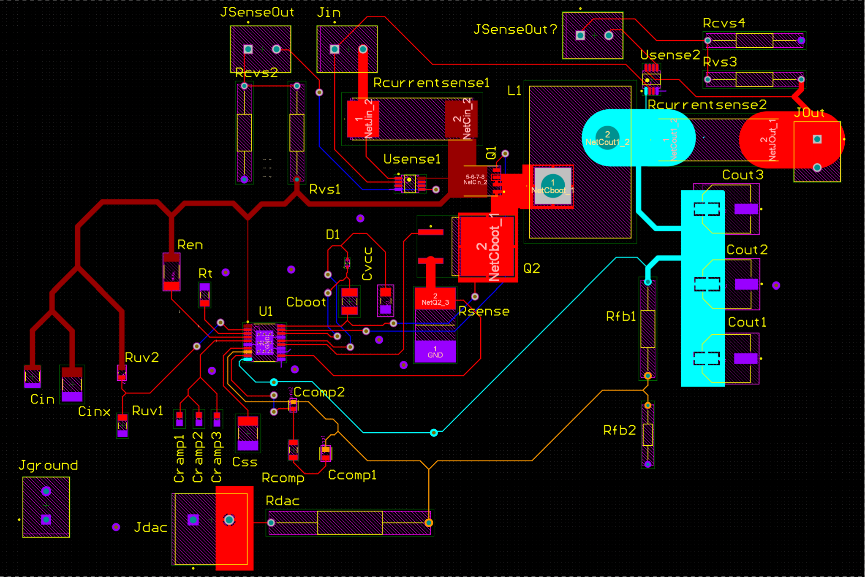
DC-DC Converter
Tarik Dawson
Control System
The current control system doesn’t effect the system’s output.
Diode may be the problem
Switching to a lower resistor to improve response.
Sensors and Switches
Sensors added into main subsystem PCB.
The switch must be added into the PCB next.
Functionality
System produces 12V and works as intended other than the control system.

Slide 11
Parts Ordering Status
Sensor and switch parts are being ordered
All components for the main PCB are ordered and received
Notes:
Michelle

Slide 12
DC-AC Inverter
Clement Ong
Accomplishments since 403 15 hrs of effort | Ongoing progress/problems and plans until the next presentation
MCU Code is producing PWM Changed MOSFETs on PerfBoard (H-bridge) Found a transformer suitable for project PCB design finalized | PWM waveform not exactly accurate Testing H-bridge with the new MOSFETs

Slide 13
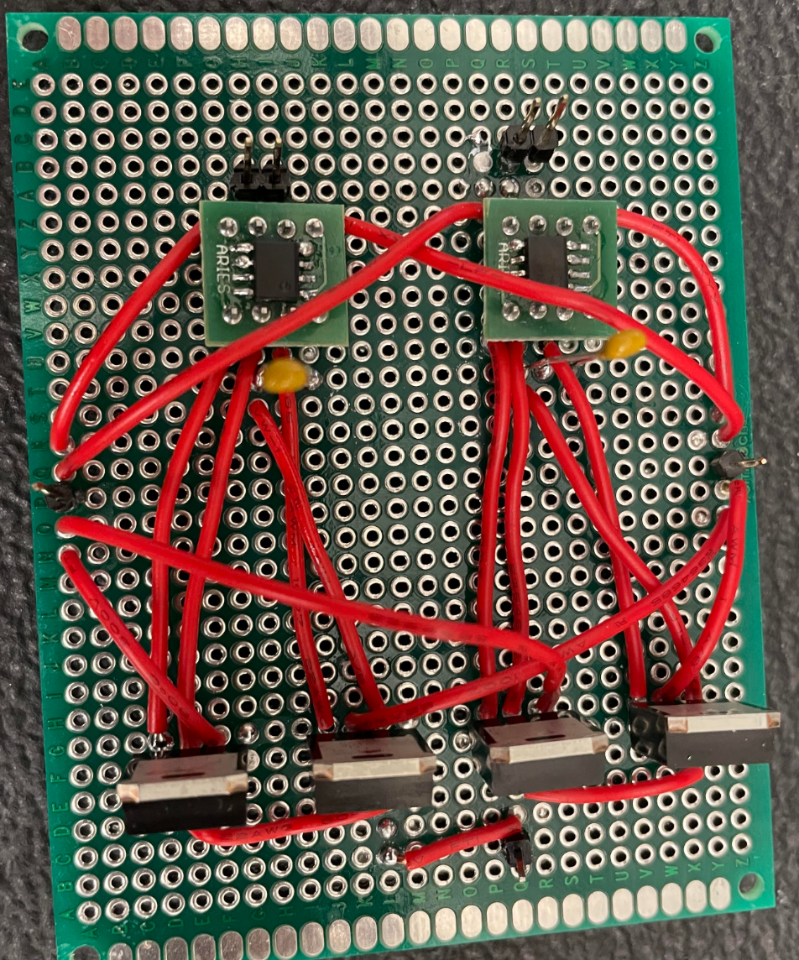
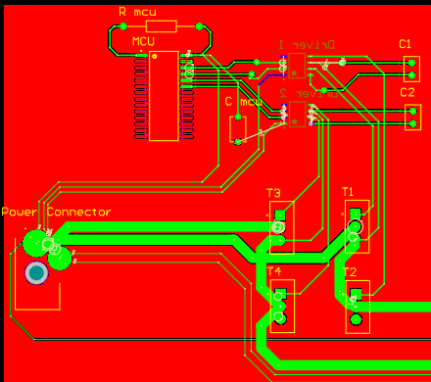
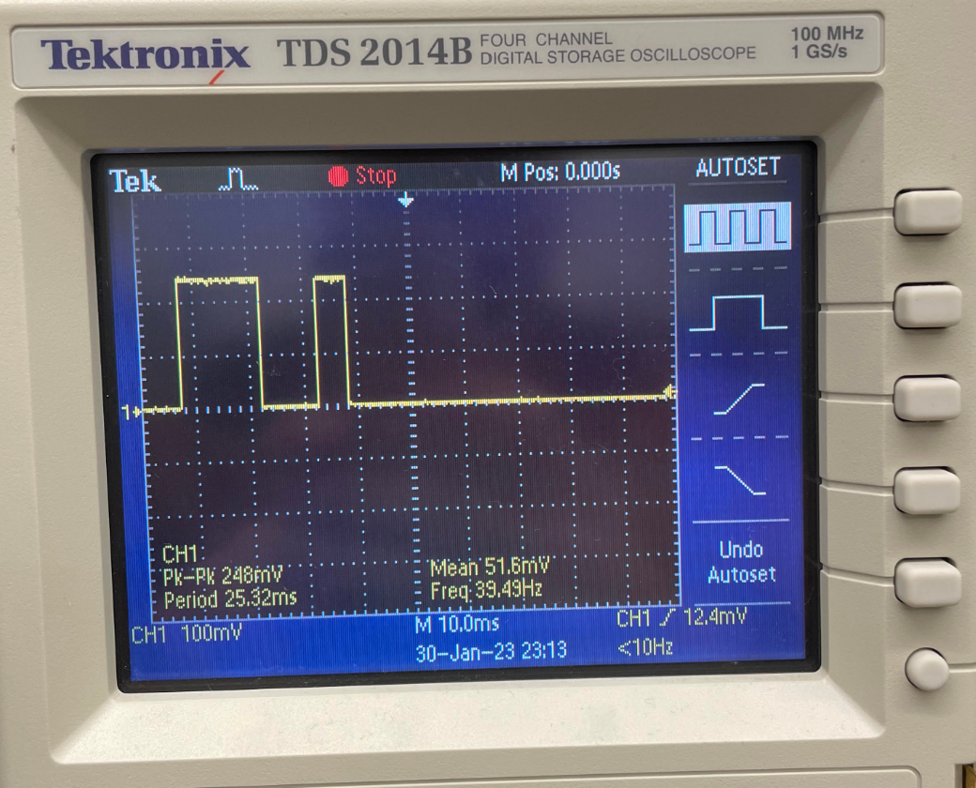
DC-AC Inverter
Clement Ong
MCU
dsPIC30F2010
Producing PWM, but large gap after each cycle
Currently debugging
H-Bridge
Built and tested on PerfBoard in 403
Losses signal at MOSFETs
Maybe V_gs not met, so full current could not flow
Changing to low power MOSFETs and testing again
Transformer
Found transformer suitable for project
100VA, 1:10
Decided to take out of PCB

Slide 14
Parts Ordering Status
Ordered and Received
MCU, MOSFETs (old and new), Drivers, Resistors, Capacitors
Not Ordered
Transformer, PCB, extra parts
Notes:
Michelle

Slide 15
Website and Android App
Nathan Gil
Accomplishments since 403 15 hrs of effort | Ongoing progress/problems and plans until the next presentation
Completed connection between UI and Firebase backend Successfully able to get Website up and Android App on android for validation Completed stylistic touches to UI (login page, graphs, etc.) Completed Authentication for Users via Email & Password Organized database by User with their Data / Preferences | Work with Lauren to get ESP32 and backend bi-directionally communicating Have ESP32 receive authenticated user, have backend authenticate ESP32 current user Get data from ESP32

Slide 16
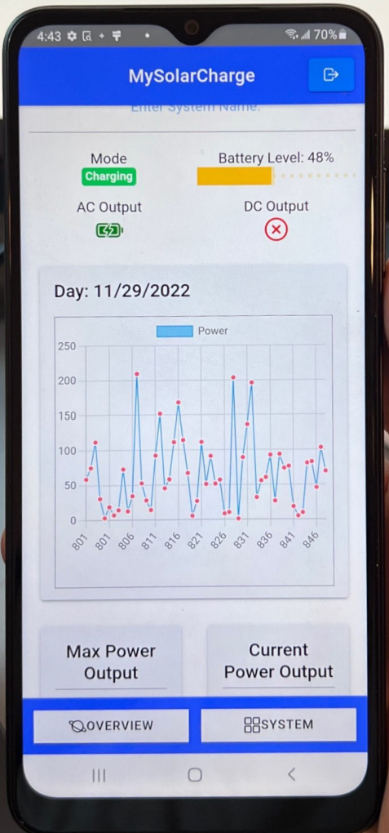
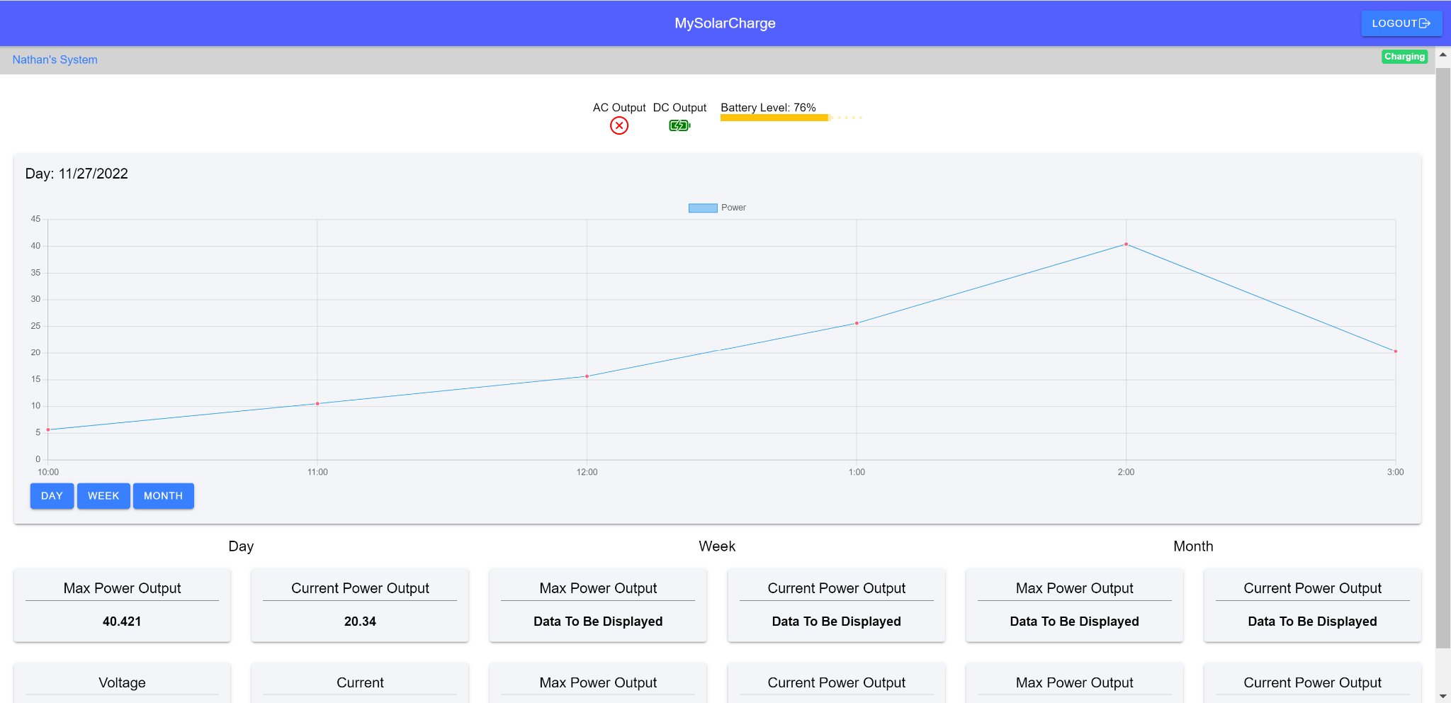
Website and Android App
Nathan Gil
UI Design for Android and Website Application:

Slide 17
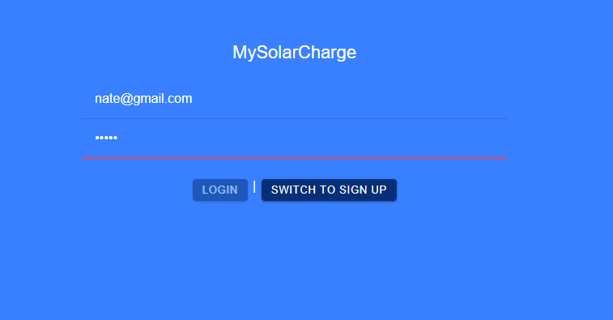
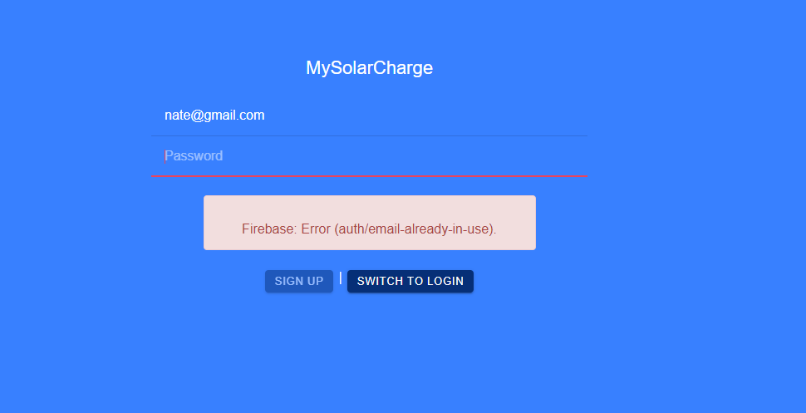
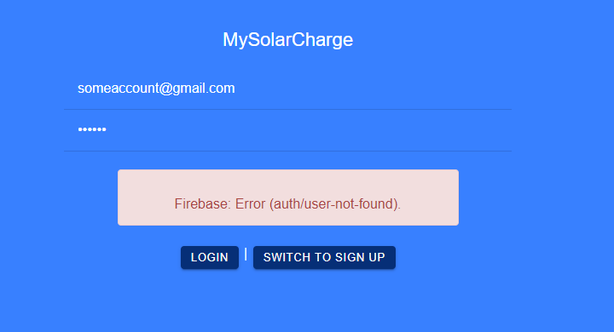
Website and Android App
Nathan Gil
UI Authentication for Android and Website Application:

Slide 18
Validation Plan
Paragraph # | Test Name | Success Criteria | Methodology | Status | Responsible Engineer
3.2.1.1 | Solar Panel Maximum Output | The Solar/battery power system functions when connected to a 220W source | Connect a 220W source to the solar/battery system and check node data | Not Tested | Clement Ong
3.2.1.2 | Range of Loads | System can power a device consuming up to 100W | Plug a 100W load into either the DC or AC output. | Not Tested | Tarik Dawson
3.2.1.3 | Switch Check | System will switch to battery power when the solar panel is not producing enough; system will open switch when solar panel is not producing; and the system will open the load switch when the battery is charging | Observe voltage output using voltage sensor (voltage divider), update status through MCU | Testing Success | Lauren Lugo
3.2.1.4 | AC Output | AC output will be identical to standard US AC outlet power | Use a multimeter to test the AC output of the system | Not Tested | Clement Ong
3.2.1.5 | Max Power Point Track | System can track the max power the solar panel can give the system | Track power through system, using voltage dividers and current sensors | Testing Success | Lauren Lugo

Slide 19
Validation Plan
Paragraph # | Test Name | Success Criteria | Methodology | Status | Responsible Engineer
3.2.1.6 | System Shut Off | System disconnects when not enough power is being supplied | Disconnect all inputs and ensure all switches receive no power | Testing Success | Lauren Lugo
3.2.2.1 | Mass | System will be no heavier than 32 kilograms | Weigh the whole system with the solar panel included | Testing Success | Tarik Dawson
3.2.3.1.1 | Power Consumption | The system will not consume more than 260W | allow the system to charge with no load, if the battery charges at all, success criteria is fulfilled | Not Tested | Lauren Lugo
3.2.3.1.2 | Input Voltage | System works with input voltage from 20V to 60V | Connect load to the system in complete darkness and when the solar panel produces max voltage | Not Tested | Tarik Dawson
3.2.3.2.1 | Data Output | The website/application subsystem is receiving data | Run system normally. If the website is getting data, success criteria is fulfilled | Testing Success | Nathan Gil
3.2.3.2.2 | Diagnostic Output | The website/application subsystem is receiving data dynamically | Run system normally. If the website is getting internal data, success criteria is fulfilled | Tested | Nathan Gil

Slide 20
Validation Plan
Paragraph # | Test Name | Success Criteria | Methodology | Status | Responsible Engineer
3.2.4.1 | Thermal | System works in the temperature range of -15 to 50 degrees Celsius | Test system functionality at -15C and 50 using heating and cooling device | Not Tested | Nathan Gil
3.2.4.2 | Rain | System works in the rain | Test system functionality in the rain | Not Tested | Tarik Dawson
3.2.4.3 | Humidity | System works for all humidity levels | Test system functionality from 0% humidity to 100% in increments of 25 | Not Tested | Tarik Dawson
3.2.5.1 | Database Operations | Firebase Backend Database successfully receives and categorizes data | Test database functionality by measuring voltage, power, etc. directly and matching it to database | Testing Success | Nathan Gil
3.2.5.2 | Application and Website Post Request | Website and Application successfully pulls data from firebase backend database | Test by outputting to the local console of website and app to confirm correct data is being pull | Testing Success | Nathan Gil
3.2.5.3 | System Display of Crucial Data | Application and Website provides correct data depending on day, week, and month | Compare display data to database, and physical components in real time (updates dynamically) | Testing Success | Nathan Gil

Slide 21
Validation Plan
Paragraph # | Test Name | Success Criteria | Methodology | Status | Responsible Engineer
3.2.5.4 | Physical Requirement | Website and Application works on android phone along with displaying properly | Test app and website on Android physical phone and interact with the applications | Testing Success | Nathan Gil
3.2.5.5 | User Authentication | Website and App will check if a user exist and if the new username is already used | Test application and check firebase authentication database to see new user and current users | Testing Success | Nathan Gil
3.2.5.6 | Existing User Authentication | Website and App will check if email is correct format, if user has right password | Test by creating a user, and trying to login with wrong password and try and make a fake email | Testing Success | Nathan Gil
N/A | Full system demo | System converts solar power to usable AC or DC power while charging a battery | Place solar panel under the sun and check outputs on both the DC and AC terminals. | Not Tested | Full team
3.2.6.1 | DC-DC Feedback Validation | DC-DC converter uses feedback from the MPPT to adjust output voltage | Vary the feedback voltage and observe if it has an effect on the output voltage | Testing Success | Tarik Dawson
3.2.6.2 | DC-DC Load Current Validation | DC-DC converter supplies 12V up to 20 Amps | Attach the system to an Eload and test the system from 0 amps to 20 amps | Test Failed | Tarik Dawson

Slide 22
Validation Plan
Paragraph # | Test Name | Success Criteria | Methodology | Status | Responsible Engineer
3.2.6.3 | DC-DC Input Range Validation | DC-DC converter works as intended with an input of 20V to 60V | Vary the input from 20 to 60 volts using high current power supply and record the results | Testing Success | Tarik Dawson
3.2.6.4 | DC-DC efficiency Validation | Efficiency is around 75% | Measure power input and power output, then calculate efficiency | Testing Success | Tarik Dawson

Slide 23
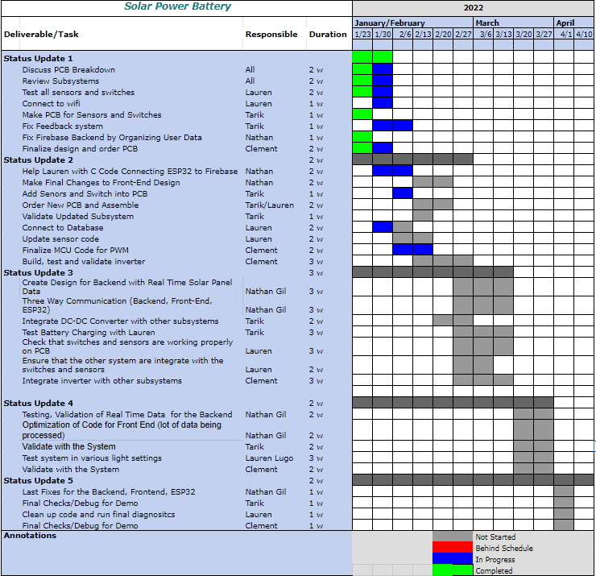
Execution Plan
Notes:
Michelle

Slide 24
Thank You!
Questions?

